Slide 1
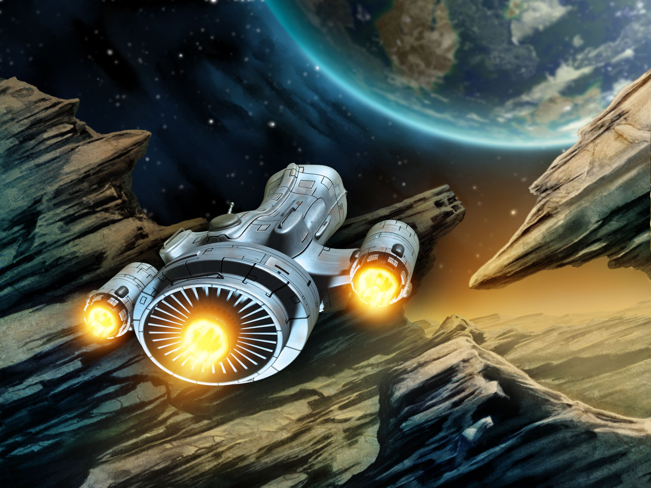
aliena-255
-A Virtual Reality Game & Exploring Kit -
By DU_Agile_Bot

Slide 2
Planet Exploration
Aliena-255 can help you explore planets and stars using virtual reality.
You can land on the explorable planets & explore them

Slide 3

Planet Customization
You can also look around the space and have the knowledge about planets. Besides you can customize their attributes and examine the impact of these changes that you are making.

Slide 4

Robo-Assistant
An interactive Robot will make the system ease. Congratulations! You got a Robo-Assistant.

Slide 5

Real life touch in VR
3D sounds and interactive motion will give you a real life touch in virtual reality.

Slide 6
Space Travel
Now, you can have the experience of an astronaut . The system will provide you a spaceship and using this spaceship you can travel into our solar system.

Slide 7

Game
Mode
Feeling bored with too much information! Do not worry. We have game mode for you which will make you excited. Two different game mode have been introduced.
You will be given information of a planet and your task is to find that planet from the star system.
You will be shown a glimpse of a planet. Your task is to determine the attributes of that planet. The more accurately you can identify, the more points you will get.

Slide 8
Cost Effective
Aliena-255 depends only a smart-phone and a google cardboard. Thus it make itself very cost effective.

Slide 9
Our Progresses

Slide 10
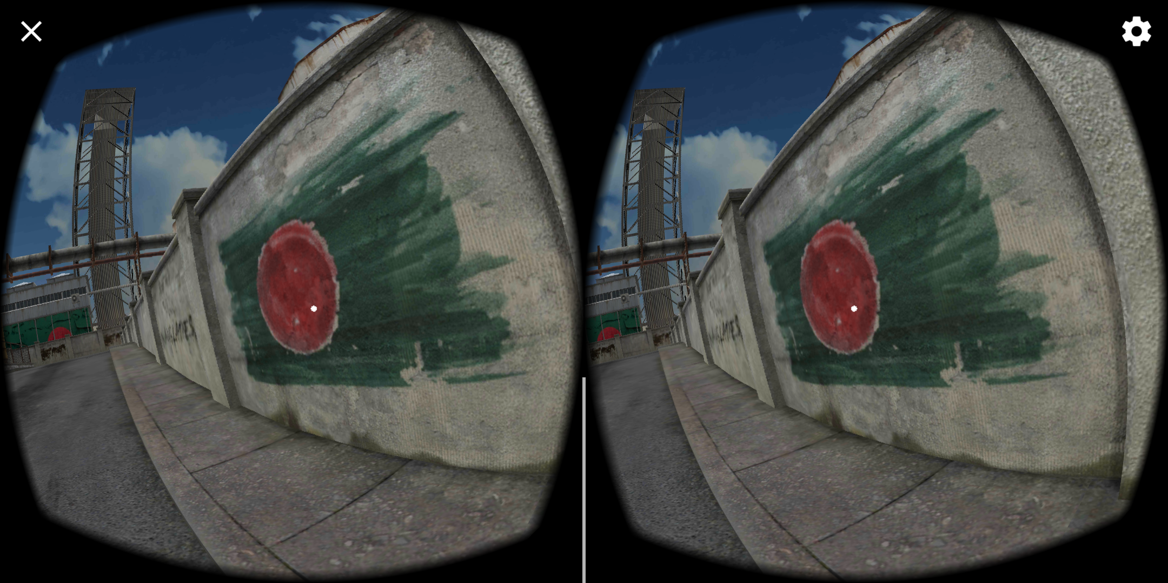

Slide 11
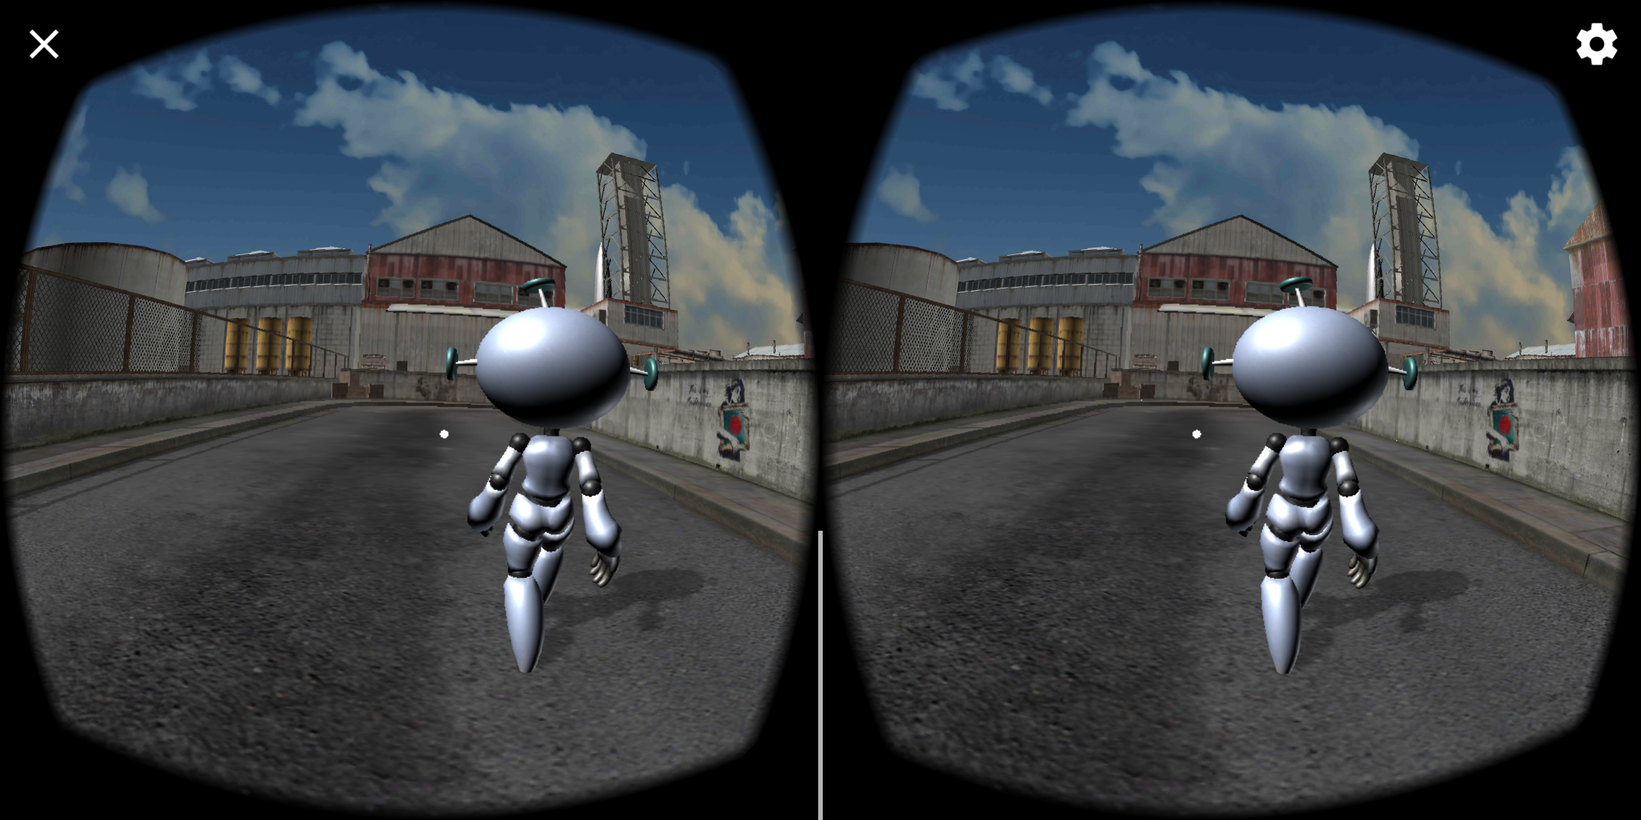

Slide 12
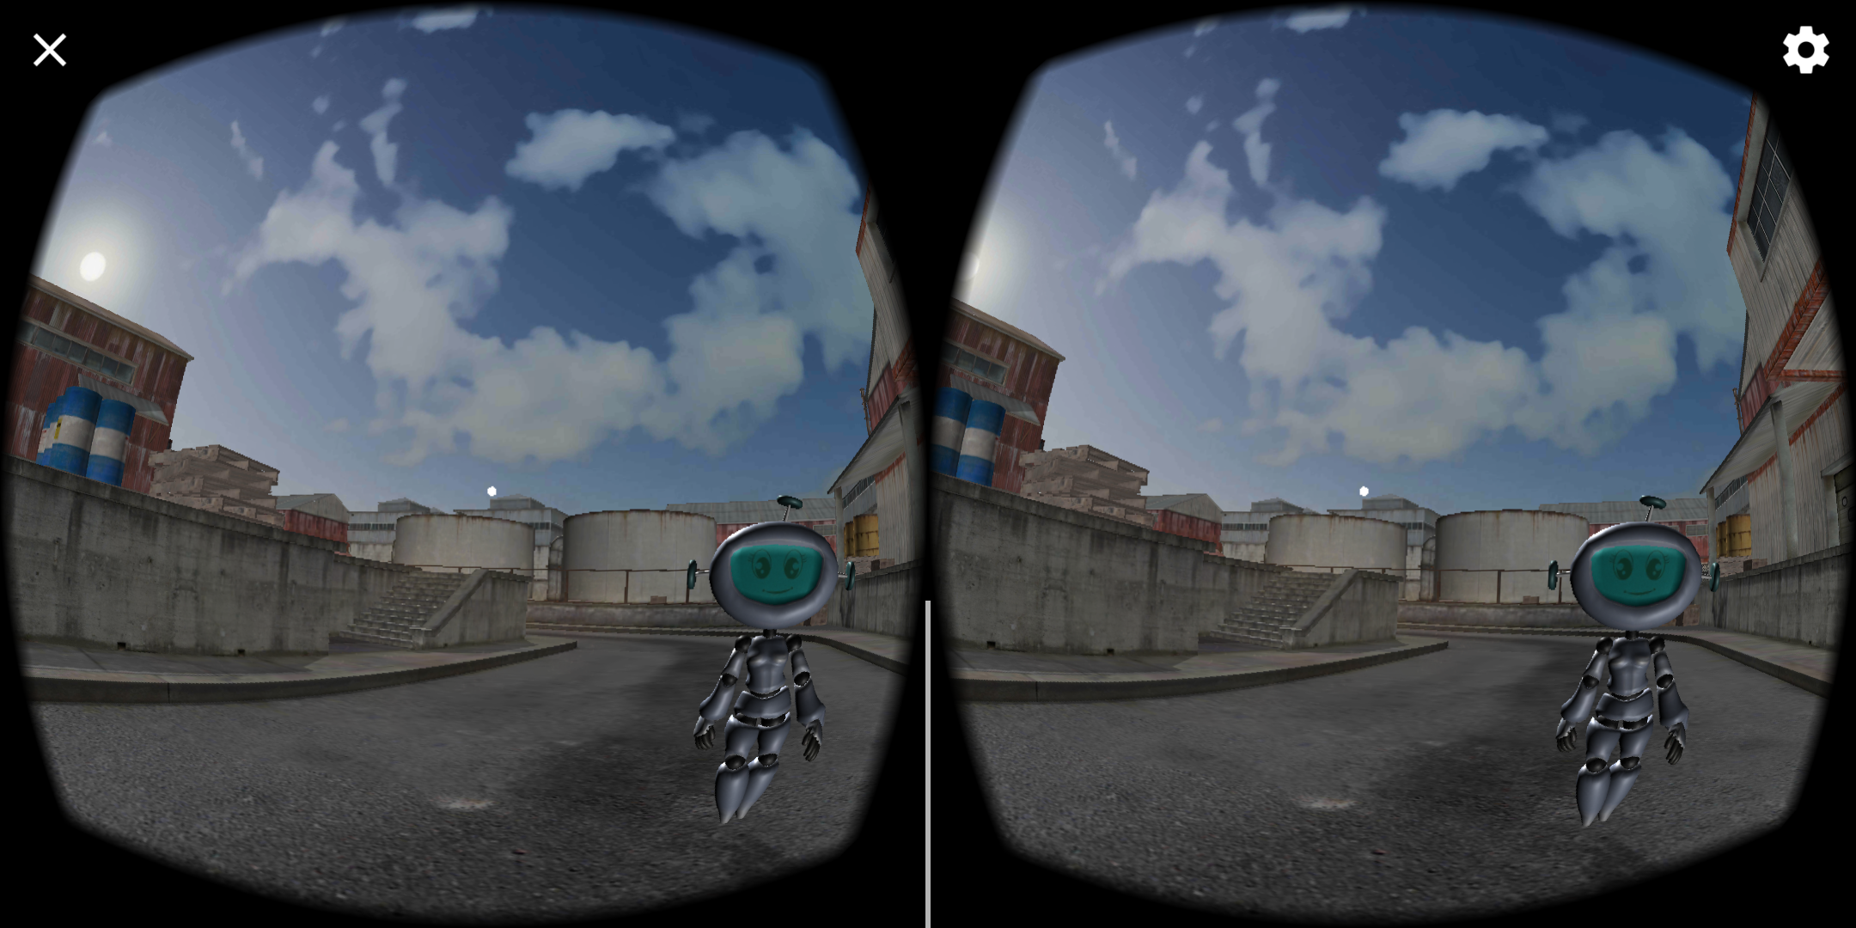

Slide 13
